Slide 1
Project Title:-
Flower Classifier with (CNN) Convolutional Neural Network
Team Leader:
Kodali Nikesh Varma (23ME5A0514)
Team Members:
Garikipati Hima (23ME1A4914)
Pathikayala Lakshmi Durga (23ME1A4946)
Morla Ahanthi (23ME1A4938)

Slide 2

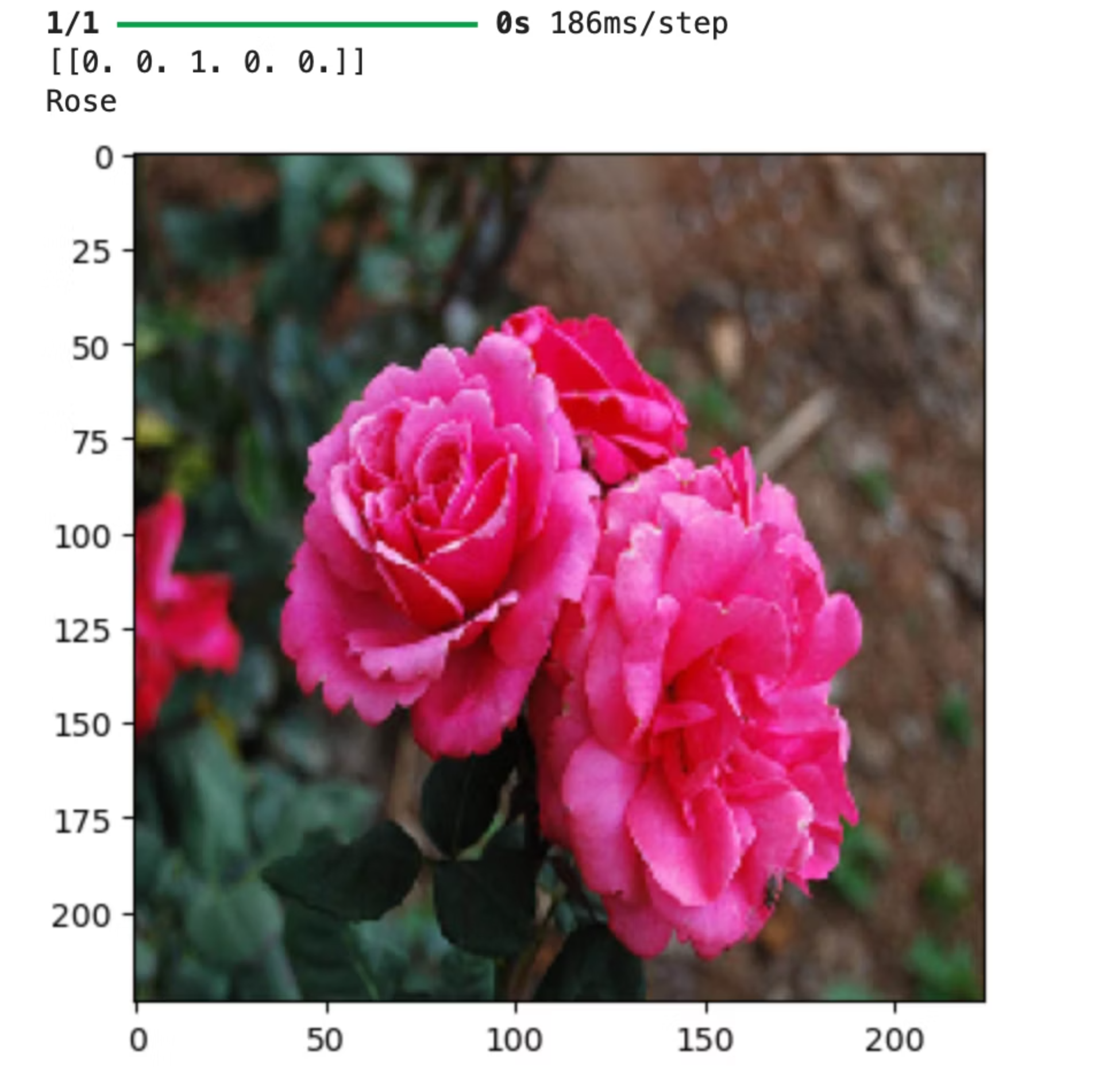
Flower Classifier with CNN
The classification of flowers plays a significant role in fields like agriculture, botany, medicine, and environmental research. Traditional methods of flower identification are often manual, time-consuming, and error-prone. With the growing availability of digital images and advancements in artificial intelligence, especially deep learning, it is now possible to automate this process with high accuracy.
Our project, "Flower Classifier with CNN (Convolutional Neural Network)", focuses on building a deep learning model that can identify and classify images of flowers into categories such as Sunflower, Wheat, Maize, and Rice. By using TensorFlow and Keras, we trained a CNN on a labeled image dataset to recognize different flower types based on their visual features like color, shape, and texture.

Slide 3
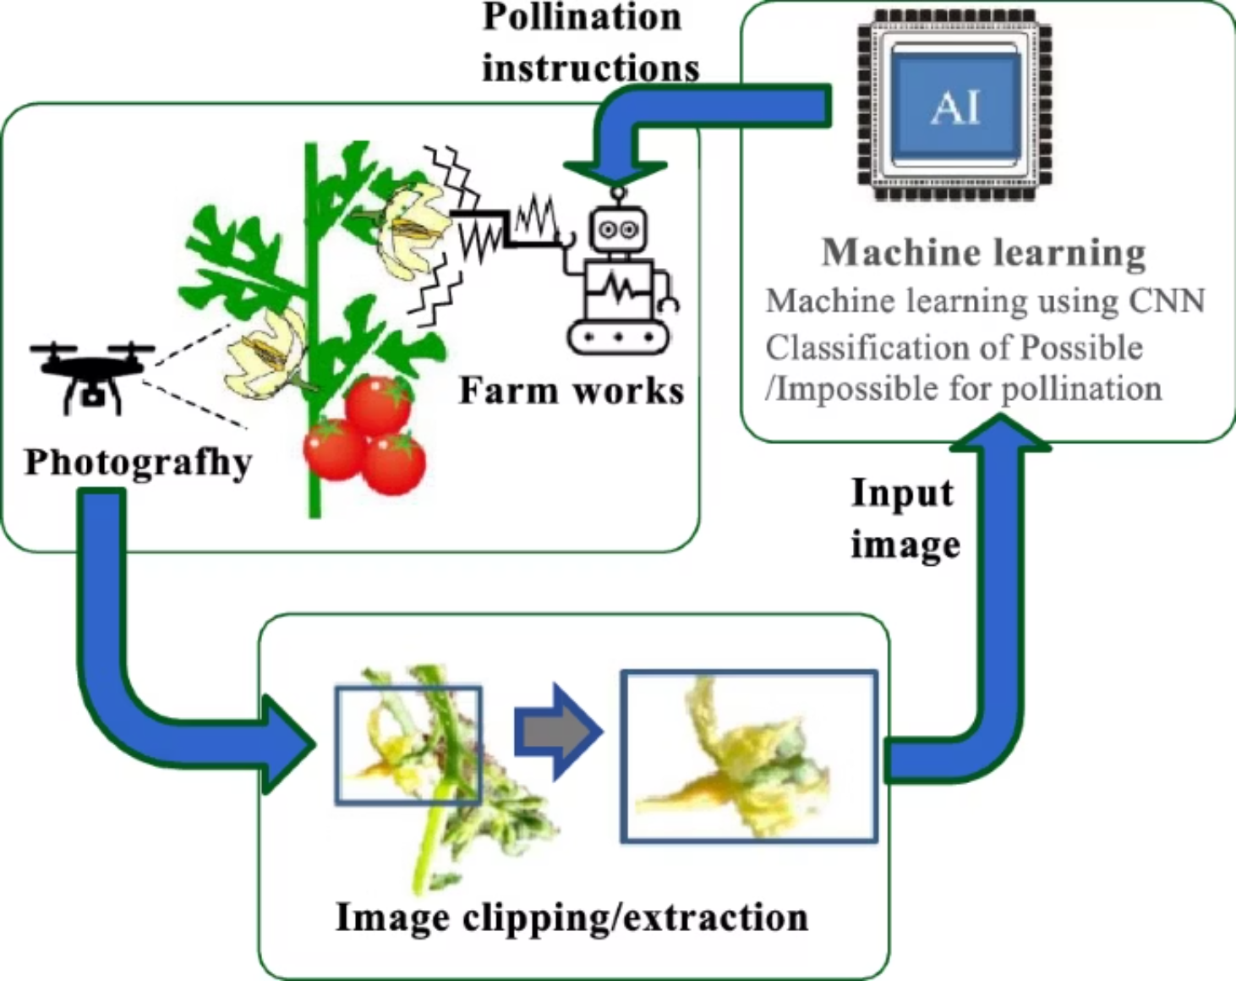
Automating Flower Classification
Manually identifying flower species is time-consuming and requires expert botanical knowledge.
Automating this process with AI offers significant benefits across multiple sectors.
Agriculture
Botany
Research
Pest detection, crop management, and yield prediction.
Accelerated research, species discovery, and biodiversity mapping.
Data collection, environmental monitoring, and ecological studies

Slide 4

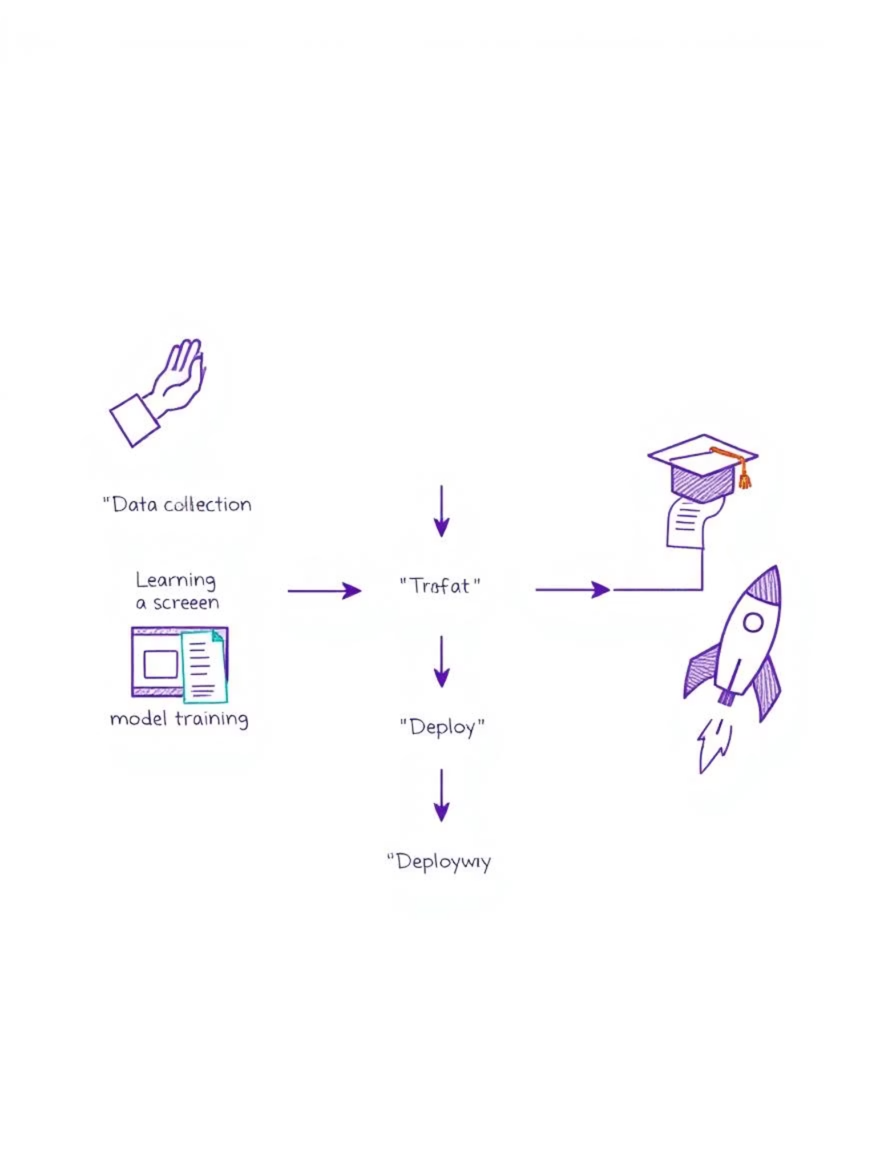
Project Objectives
1
Build CNN Model
Develop a robust Convolutional Neural Network for image classification.
2
Train & Validate
Utilise extensive image datasets for training and validation processes.
3
Achieve High Accuracy
Aim for precise and reliable predictions of flower types.
4
Save Model
Ensure the trained model is saved for future integration and use.

Slide 5




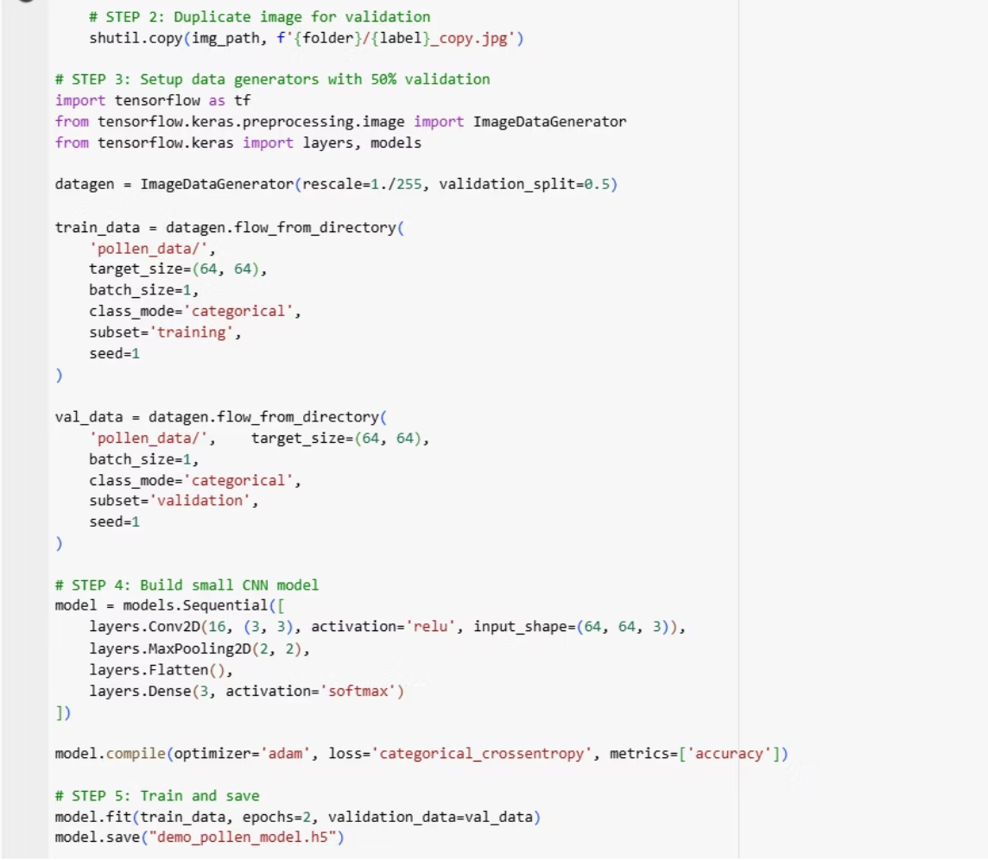
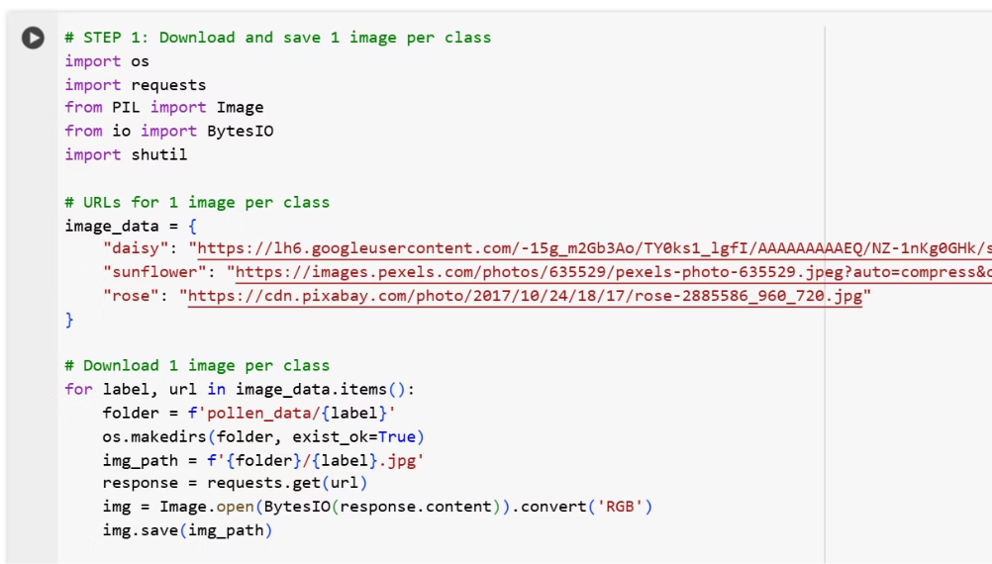
Our Technology Stack
Our project leverages powerful tools and frameworks for deep learning development.
This selection ensures efficient model training and deployment.
Python
TensorFlow
The core programming language for model development.
Primary deep learning framework for building neural networks.
Keras
CNN
High-level API for rapid prototyping and experimentation.
Convolutional Neural Network architecture for image processing.
Actual Code:-

Slide 6
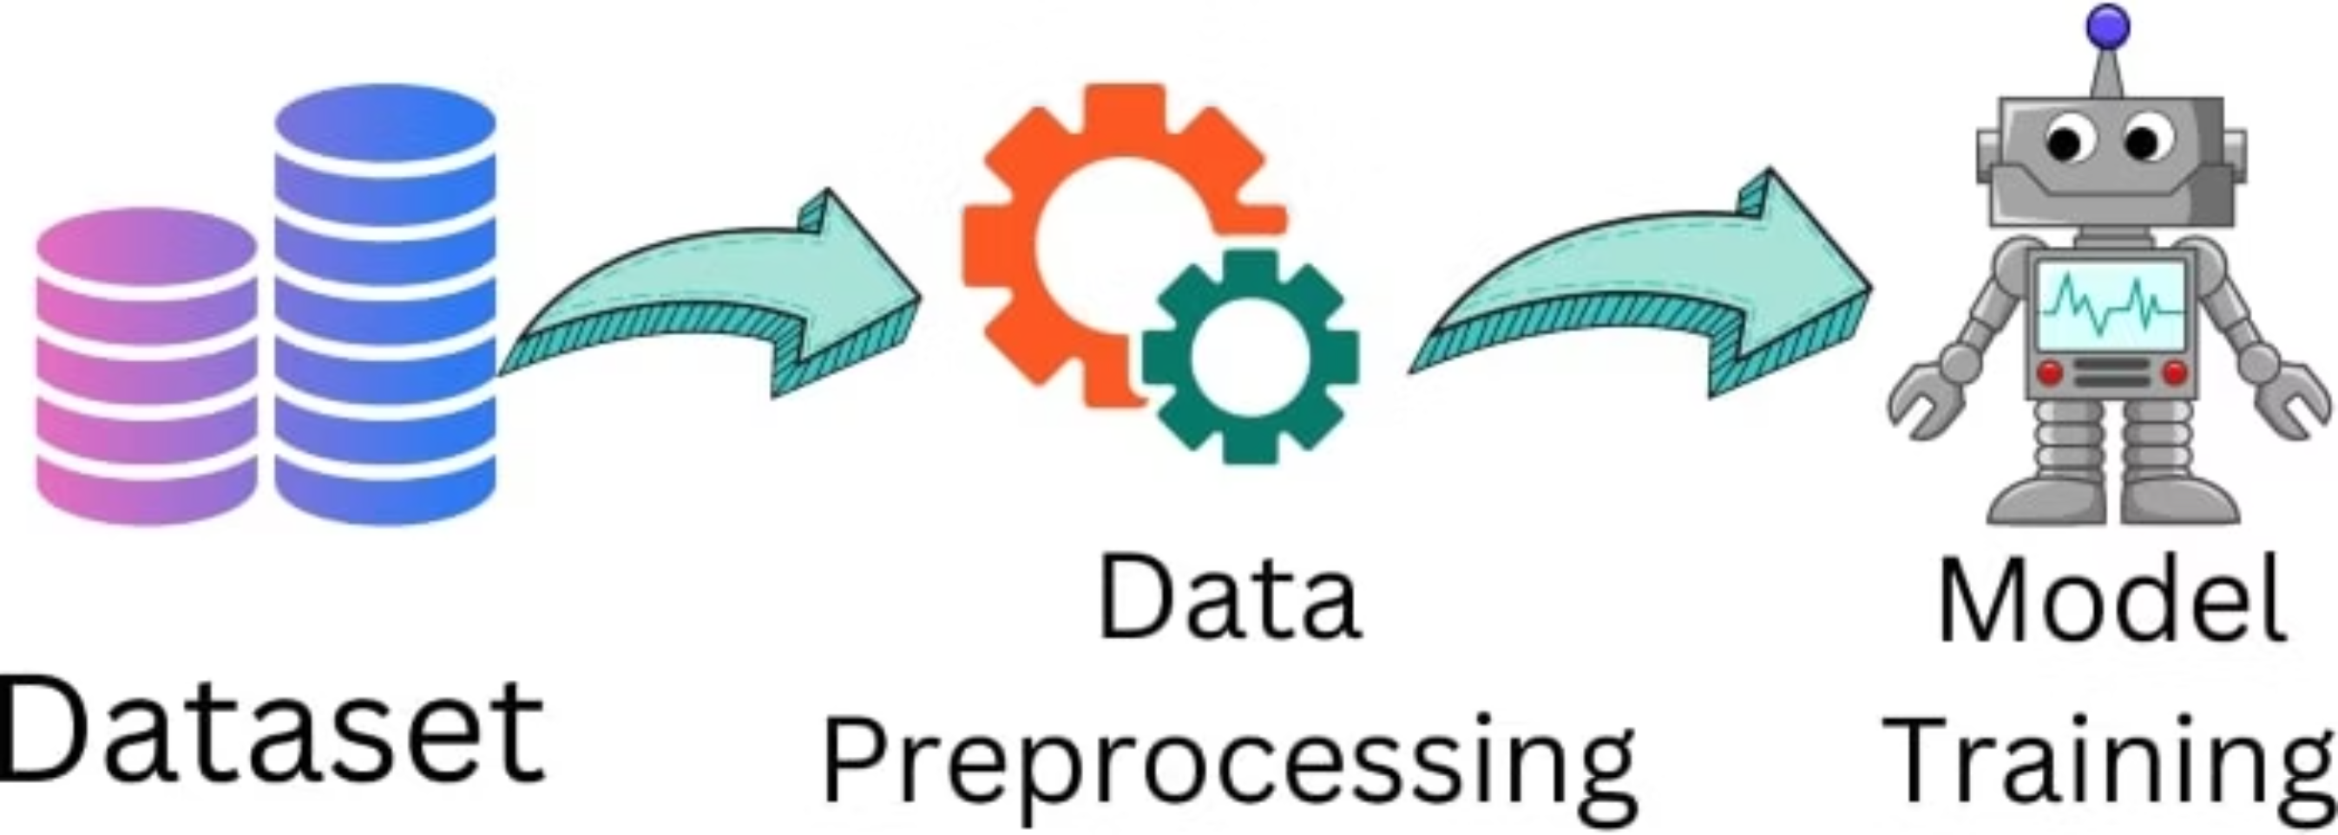
Dataset and Preprocessing
Our model's performance relies on a well-structured and preprocessed dataset.
Image data is meticulously prepared for optimal training.
Dataset Structure
Preprocessing
Images are organised in a folder-based hierarchy: flower_type/images.
ImageDataGenerator: Used for real-time data augmentation.
This structure simplifies data loading and labelling.
Image Resizing: Standardised image dimensions for consistent input.
Split Data: Divided into training and validation sets (e.g., 80/20).

Slide 7
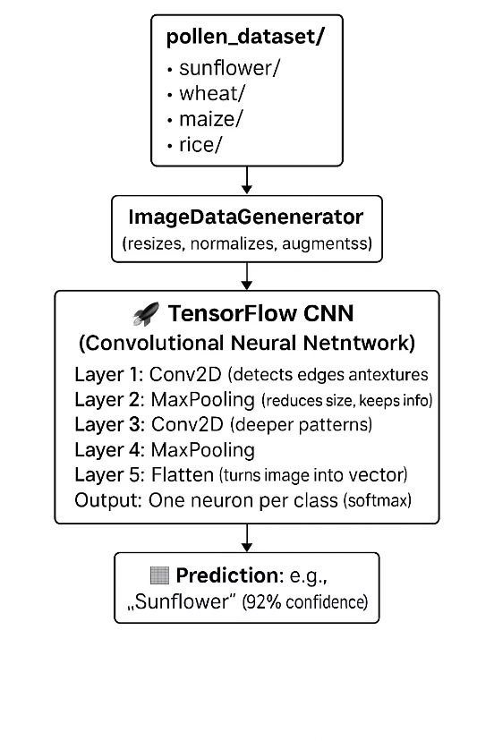
Model Architecture
Our flower classification model uses a Convolutional Neural Network (CNN) built with TensorFlow and Keras. CNNs are ideal for image recognition tasks as they learn patterns like edges, shapes, and textures automatically.
🔷 Layer-by-Layer Overview:
Input Layer:Accepts flower images resized to 128x128 pixels with 3 color channels (RGB). Images are normalized using ImageDataGenerator.
Conv2D Layer 1:Applies 32 filters (3x3) to detect basic features like edges. Activation: ReLU
MaxPooling2D Layer 1:Reduces image size to lower complexity and focus on key features.
Conv2D Layer 2:Applies 64 filters (3x3) to detect deeper patterns. Activation: ReLU
MaxPooling2D Layer 2:Further downsamples the image for efficiency.
Flatten Layer:Converts the 2D output to a 1D vector for the dense layers.
Dense Layer:Contains 128 neurons with ReLU activation to learn complex patterns.
Dropout Layer:Drops 50% of neurons during training to reduce overfitting.
Output Layer:A Softmax layer with neurons equal to the number of flower categories (Sunflower, Wheat, Maize, Rice) — returns class probabilities.
⚙️ Training Setup:
Optimizer: Adam
Loss Function: Categorical Crossentropy
Metric: Accuracy

Slide 8
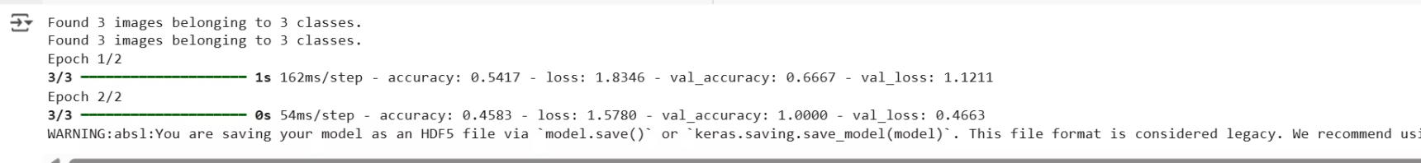
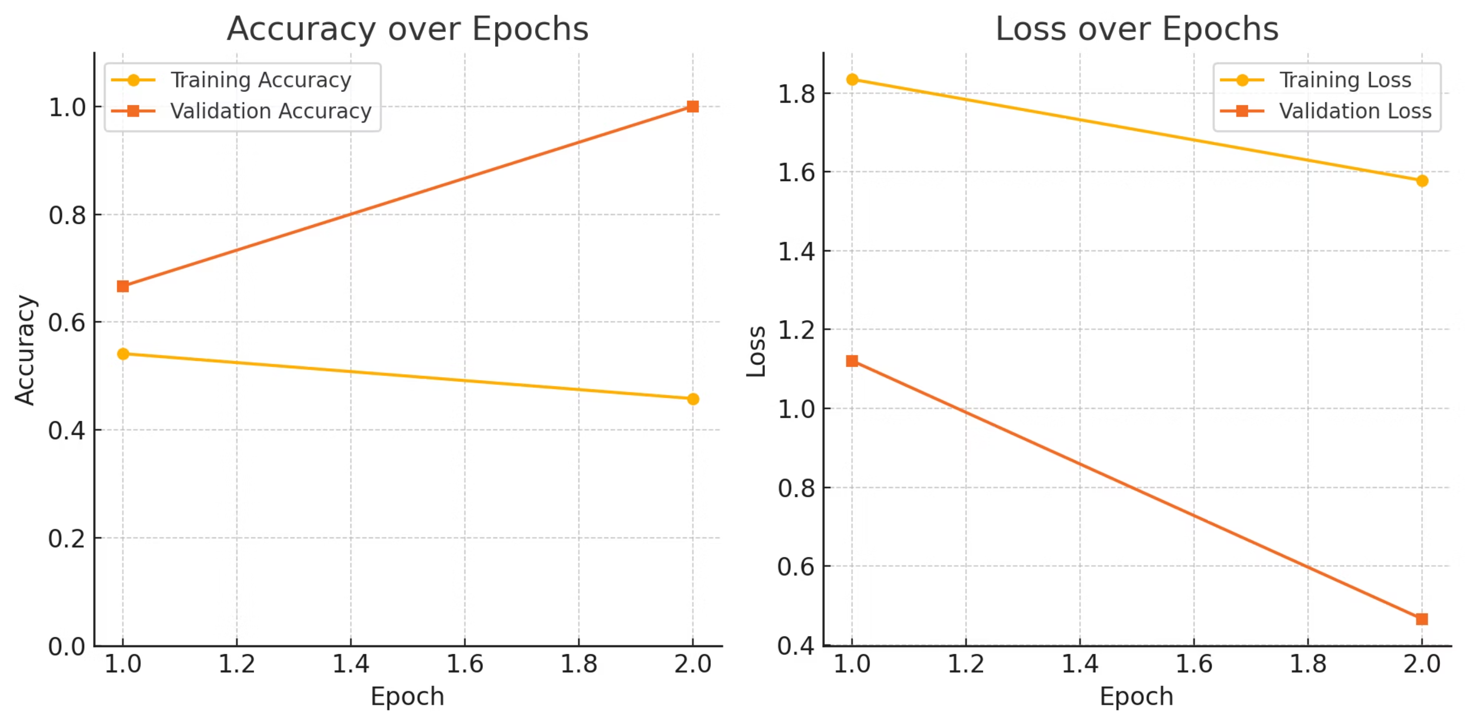
Results & Accuracy
Our model demonstrated strong performance during training and validation.
The results indicate high accuracy in classifying flower types.
Output:-
Here is the generated graph showing:
d
Training and Validation Accuracy
Training and Validation Loss
across the 2 epochs based on your model's output. You can adthis to your PPT under the slide title
"Model Performance Graphs" or "Training vs Validation Results".

Slide 9
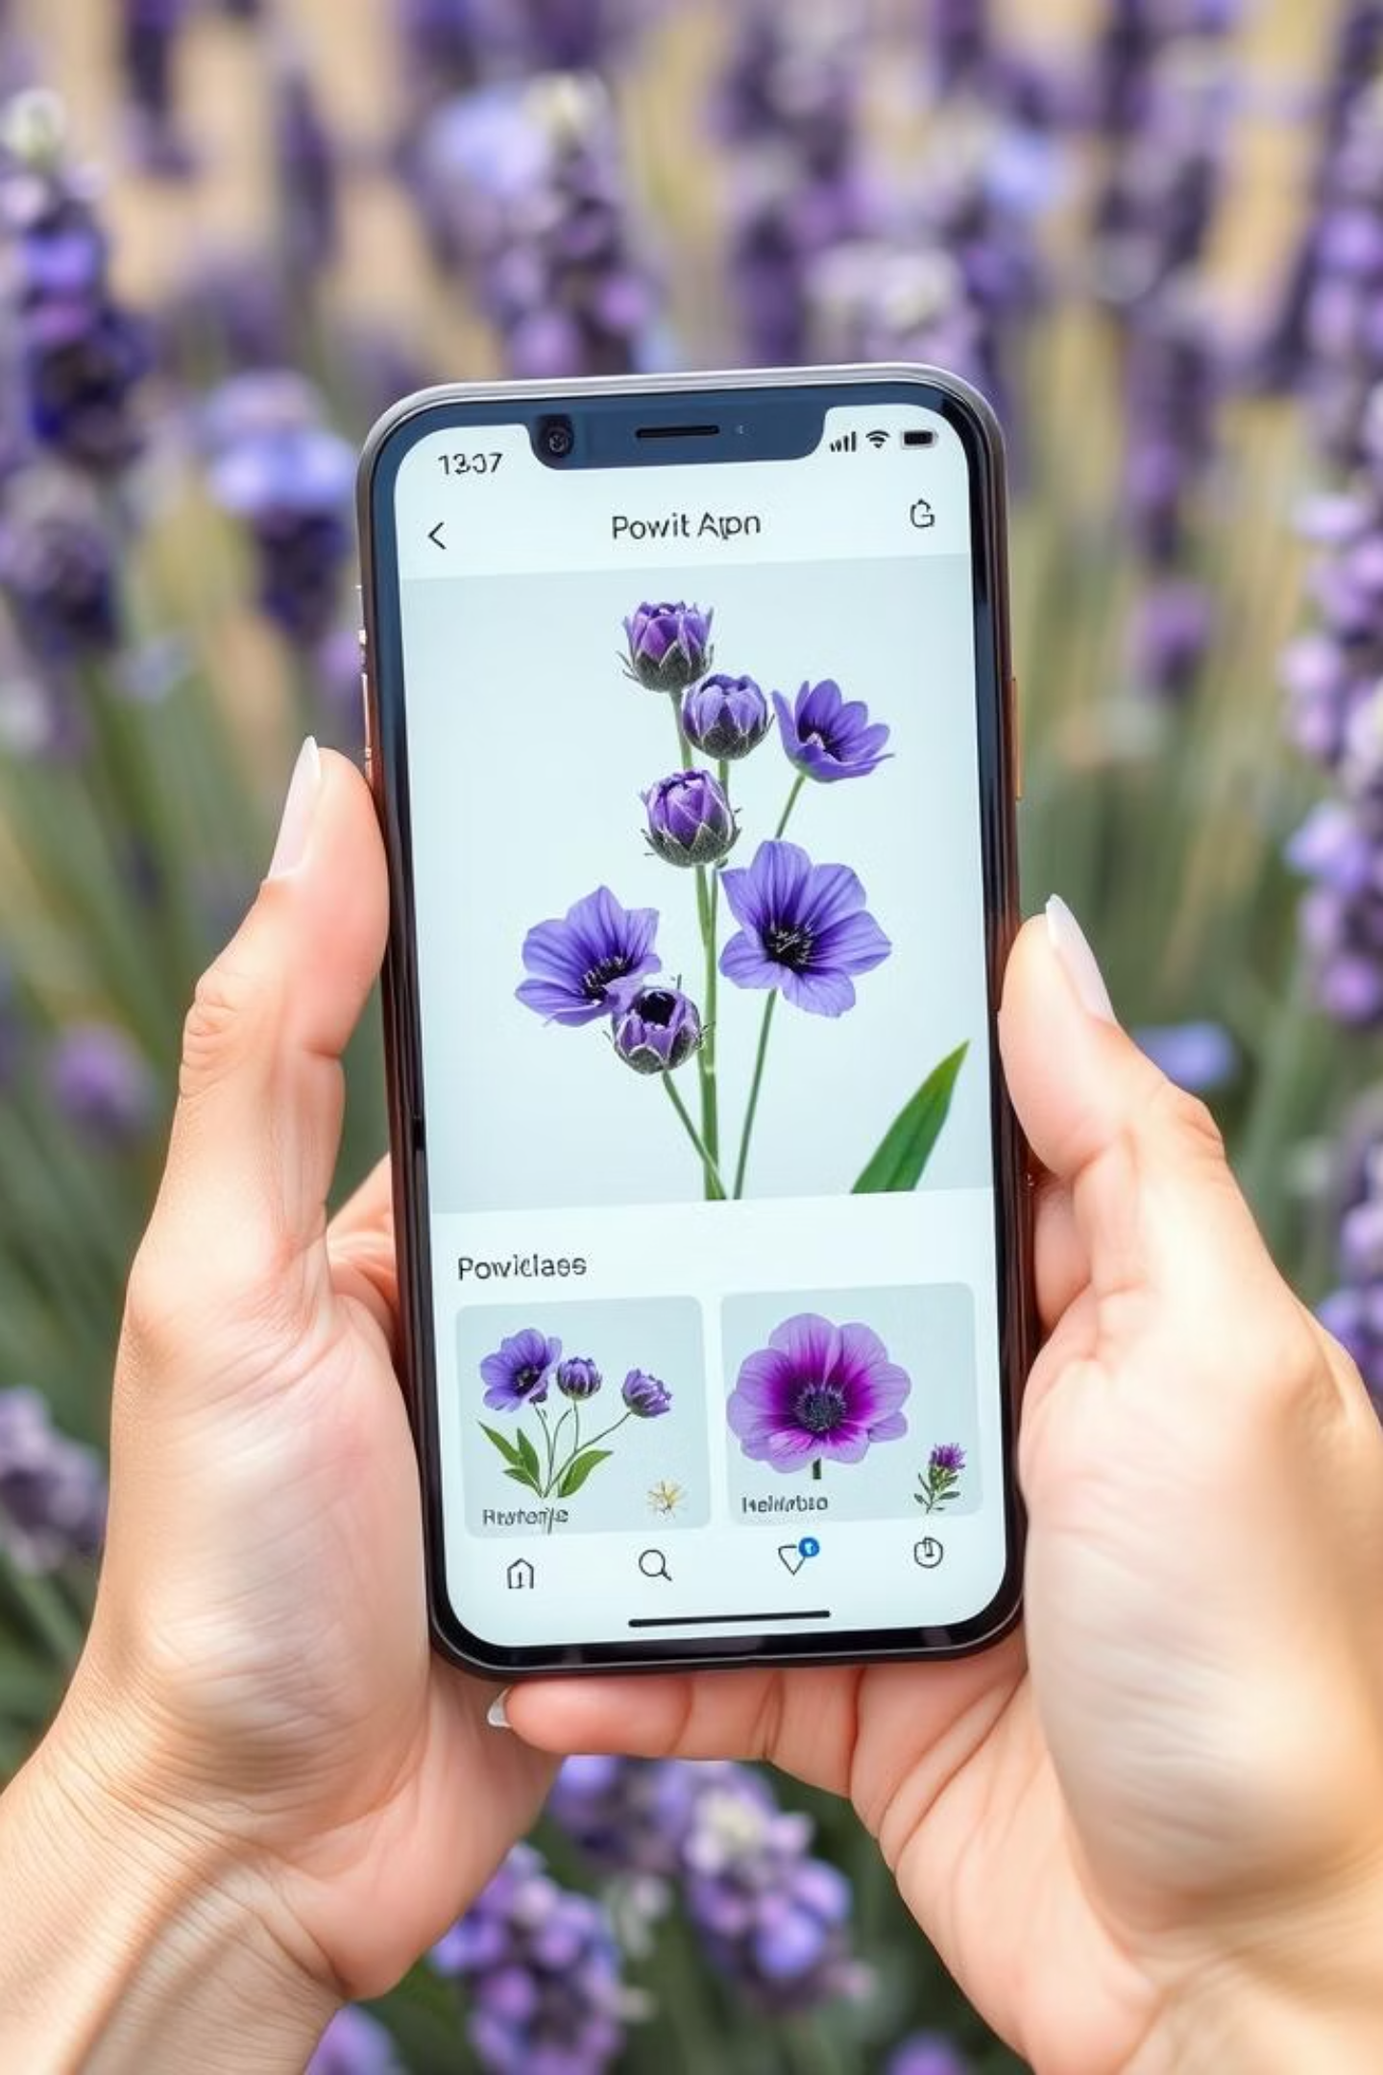
Conclusion & Future Work
Our Flower Classifier CNN successfully identifies flower species with high accuracy.
This project lays a strong foundation for future advancements and real-world applications.
Achievements
Developed and validated a high-accuracy CNN model for flower classification.
Improvements
Explore more complex architectures and larger datasets for enhanced performance.
Real-World Applications
Integrate into a mobile app for agricultural field assistance or botanical research.

Slide 10
Thank You
Flower Classifier with CNN
We sincerely thank our, mentors, and guides for their constant support and encouragement throughout this project.

